Slide 1
Sleep duration predicts Time spent on homework among Mexican AMerican youth: a daily diary study
Xiaoran Sun
May 4th, 2017
Co-authors: Susan M. McHale & Kimberly A. Updegraff
PSU Mini-Conference on Multivariate/Longitudinal Methods
Funding was provided by NICHD grants R01HD39666 (Kimberly A. Updegraff, PI) and R01-HD32336 (Ann C. Crouter & Susan M. McHale, Co-PIs).

Slide 2
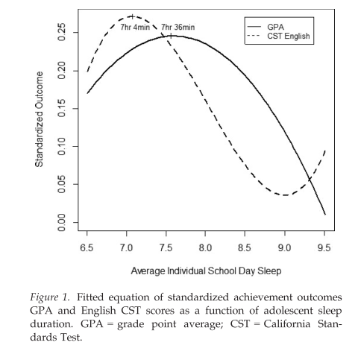
Background: sleep and academic outcomes
Curvilinear association between sleep duration (averaged across days) and GPA (Eide & Showalter, 2013; Fuligni et al., 2017)
--interindividual differences
We need to move beyond the interindividual differences to examine intraindividual associations
-> Associations between sleep and academic activity (i.e., homework time) on a daily basis
Notes:
Previous daily diary study findings:
Fuligni, 2005 (homogeneous sample): “Receiving less sleep at night, in turn, was modestly but consistently related to higher levels of anxiety, depressive feelings, and fatigue during the following day.”; “the daily variability in adolescents’ sleep time was notable and just as important for the youths’ average levels of daily psychological well being as was the average amount of time spent sleeping each night”
Delete the “therefore”
Within-person variations in
However, there are limited explanations for this association pattern
Possible explanations:
At a certain range (left side of the optimal point), more sleep -> better cognitive functioning -> higher GPA
However, spending too much time on sleep (right side of the optimal point) -> less time available to spend on study -> lower GPA

Slide 3
The present study: Sleep duration and homework time among Mexican American youth
Ethnic homogeneous design: Mexican American youth
Mexican American population: Large and rapidly growing in the U.S.; 30% under age 18 (U.S. Census Bureau, 2007)
However, Mexican American youth have lowest academic achievement across minority groups in U.S. (U.S. Census Bureau, 2007) → important to study reasons as well as factors that can be intervened to improve their achievement
There are ethnic/cultural differences in children’s and adolescents’ sleep patterns (Moore et al., 2011)
e.g., In Latino culture, sleep is often viewed as positive and necessary (Loredo et al., 2010)
Notes:
Talk about Mexican-origin background first

Slide 4
The present study: Sleep duration and homework time among Mexican American youth
Sample
Two siblings from 237 families where at least mothers were of Mexican origin
Younger siblings at 7th grade; 12.8 (SD = .58) years old; 51% female
Older siblings 15.70 (SD = 1.6) years old, 50% female
Using daily (“nightly”) diary data
7 nightly phone surveys
Younger and older siblings separately reported the activities (including duration and companions) they had engaged in (including nighttime sleep) during the past 24 hour period of the call.
Study variables
Sleep duration at each night -- IV
Homework time on the following day -- DV
Notes:
Check the language “Mexican-origin”
Be clear about sibo v. siby
Wides

Slide 5
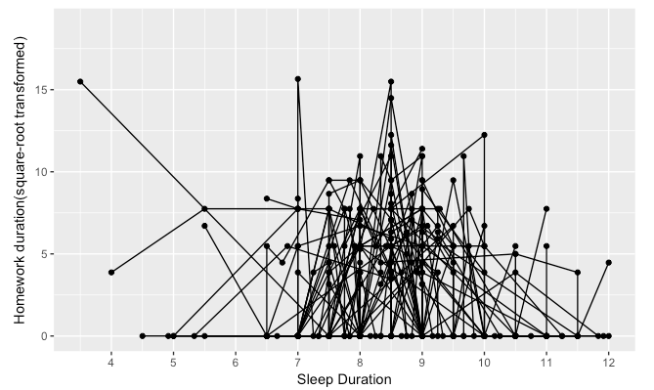
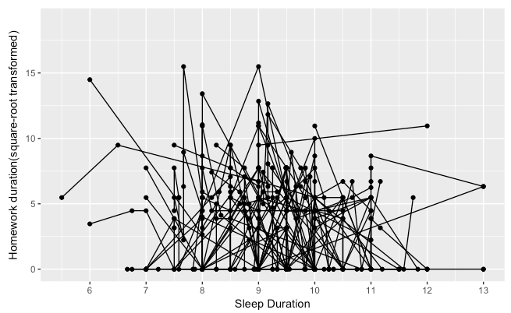
Plotting sleep duration and homework time
Older siblings (random n = 50)
Younger siblings (random n = 50)
Notes:
Seems like quadratic curve

Slide 6
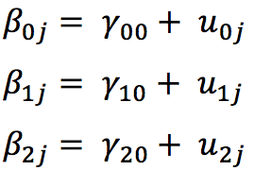
Data Analyses: Polynomial association between sleep duration and homework time
Level 1:
Level 2:
Fixed
Random
Notes:
Tried linear, quadratic, and cubic terms… stopped with the cubic term (N.S.) and determined the polynomial association to be quadratic
Also, the goodness-of-fit of the model with random effects of linear and quadratic sleep duration was significantly higher than the model with only random intercept

Slide 7
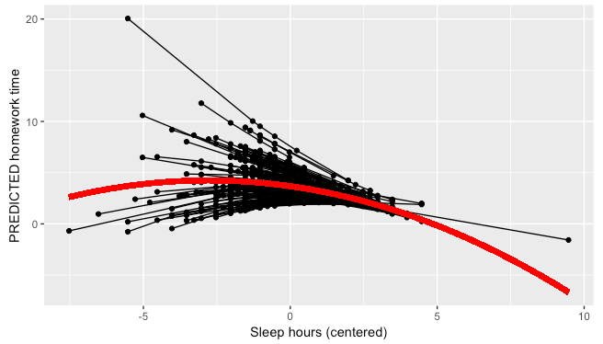
Results: Quadratic association between sleep duration and homework time – older siblings
Fixed effects
Intercept 3.68***(0.15)
Linear sleep duration -0.40 (0.09)***
Quadratic sleep duration -0.07 (0.03)*
Random effects
Intercept 1.44 [1.14, 1.82]
Sleep duration linear 0.55 [0.29, 1.02]
Sleep duration quadratic 0.10 [0.02, 0.54]
cor (Intercept, linear) -0.95 [-1.00, 1.00]
cor (Intercept, quadratic) 0.47 [-0.88, 0.98]
cor (Linear, quadratic) -0.54 [-0.96, 0.64]
Residual 3.47 [3.30, 3.63]
Highest predicted homework time is at 5.74 (5hr 44min) sleep duration
Notes:
Remember to interpret the significant random effects when giving the presentation
Interpret the curvilinear association between sleep hours and homework time
Table

Slide 8
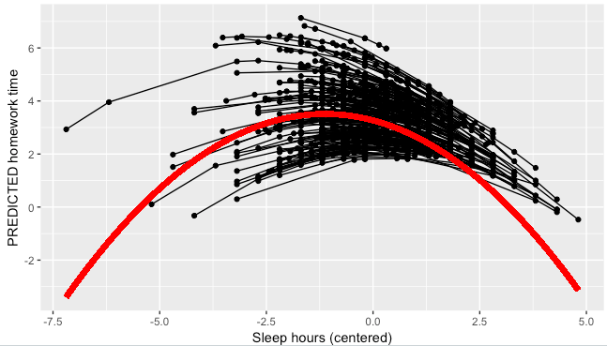
Results: Quadratic association between sleep duration and homework time – younger siblings
Fixed effects
Intercept 3.52***(0.13)
Linear sleep duration -0.27 (0.07)***
Quadratic sleep duration -0.13 (0.03)***
Random effects
Intercept 1.30 [1.08, 1.55] (sig.)
Sleep duration linear 0.18 [0.34, 0.66]
cor (Intercept, linear) -0.98 [-0.75, 0.29]
Residual 3.21 [3.08, 3.33]
Highest predicted homework time is at 8.06 (8hr 4min) sleep duration
Notes:
Interpret the curvilinear association between sleep hours and homework time
(Note: With random quadratic effect is included in the model, the estimated variance-covariance matrix is not positive definite; so the quadratic term is removed from the random part)

Slide 9
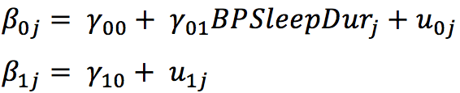
More analyses… Separating “within-person” and “between-person” effects
Between-person (BP): Average sleep duration across seven calls
Testing interindividual differences
Within-person (WP): Each night’s sleep duration centered around the person mean
Testing intraindividual differences (how much more/less sleep youth had than usual)
Level 1:
Level 2:
Fixed
Random
Notes:
Rationale: the significant random effects among both older and younger siblings -> intraindividual differences
Model comparison result: model with the random effect of within-person is significantly better than model with only fixed effects

Slide 10
Results: Within-Person v. Between-Person effects
Older siblings
Fixed effects
Intercept 5.85***(1.35)
BP sleep duration -0.27 (0.16), p = .083
WP sleep duration -0.48 (0.09)***
Younger siblings
Fixed effects
Intercept 2.05 (1.45)
BP sleep duration 0.13 (0.16)
WP sleep duration -0.41 (0.08)***
The association between sleep duration and homework time is more intradividual than interindividual:
Controlling for person’s mean sleep duration, on occasions where the youth reported higher sleep duration than usual, they also reported less homework time than usual
Notes:
Getting more sleep time-> more efficient in homework completion or spend less time on homework?
Visual

Slide 11
Conclusions
Curvilinear association between sleep duration and homework time on a daily basis
Highest point differed between older siblings (5hr 44min) and younger siblings (8hr 44min) -> developmental difference
At the left side of the highest point, as sleep duration decreases, homework time also decreases -> they do less homework when sleep less in the low range
At the right side of the highest point, as sleep duration increases, homework time decreases -> with more sleep, they probably have less time available to homework
Intraindividual differences in the association:
It is how much more/less sleep that youth have than usual (not their sleep duration in general) that can predict their homework time
Notes:
What does the highest’s point mean-

Slide 12
Future directions…
Moderators: gender, GPA, SES,…
Combine older and younger siblings in one model
Separate models for school days and non-school days
Examine other study-related activities (e.g., reading) in addition to the homework time
Other ethnic groups
Notes:
Future directions:
Moderators: gender; GPA
Separately test models for school days and non-school days
From a family systems perspective: test covariation between siblings’ sleep time and their achievement
Duration of other activities
From a family systems perspective -> test covariation between siblings’ sleep time and their achievement

Slide 13
Thanks for attention! Questions? Contact: Xiaoran Sun xbs5014@psu.edu

Slide 14
Background: sleep and academic outcomes
On a daily basis, previous findings include:
Less sleep at night -> higher levels of anxiety, depressive feelings, and fatigue during the following day (Fuligni, 2005), which may interfere with study
Sacrifice sleep for study at night -> next day’s more trouble understanding study materials and doing assignments (Gillen-O'Neel, Huynh, & Fuligni, 2012)
Question: Whether & how does sleep duration predict study time on the following day?
Notes:
Previous daily diary study findings:
Fuligni, 2005 (heterogeneous sample): “Receiving less sleep at night, in turn, was modestly but consistently related to higher levels of anxiety, depressive feelings, and fatigue during the following day.”; “the daily variability in adolescents’ sleep time was notable and just as important for the youths’ average levels of daily psychological well being as was the average amount of time spent sleeping each night”
Probably mention: I know there must be a lot of underlying physiological processes going on and I hope some of you can provide me with some perspectives and knowledge on it.
Visually display
Emphasize the question

Slide 15
Data preparation for models
Within-person variation & Between-person variation of homework time:
Level 1:
Level 2:
Older siblings:
Within-person variance: 3.61; 69%
Between-person variance: 1.58; 31%
Younger siblings:
Within-person variance: 3.28; 73%
Between-person variance: 1.22; 27%
Notes:
Using “empty” models to get the WP and BP variance
We can see there are large portions of within-person variation, that is, over-time change, among both older and younger siblings
Delete this

Slide 16
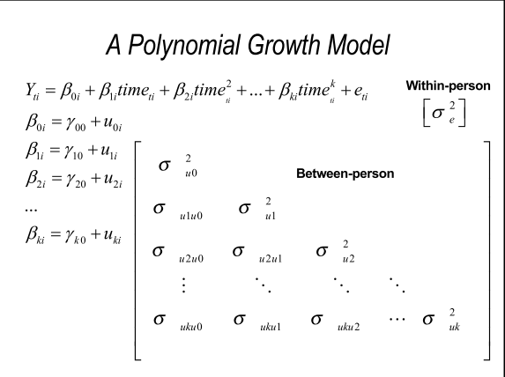
Data Analyses: Sleep duration predicts homework time [An extension of growth modeling]
Instead of “time” in the common sense, I use sleep duration (centered at the grand mean) as the “time” metric here
Notes:
Just say it

Slide 17
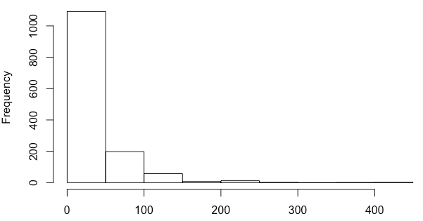
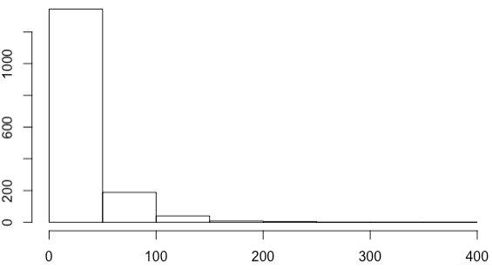
Data preparation – Daily homework time (in min)
Older siblings (N = 196)
M = 27.88, SD = 44.77
Range 0 - 425
Skew = 3.15; Kurtosis = 15.69
Younger siblings (N = 227)
M = 23.16, SD = 34.88
Range 0 - 360
Skew = 3.01; Kurtosis = 15.44
Notes:
Descriptives for older and younger in different slides but homework time and sleep duration in the same slide

Slide 18
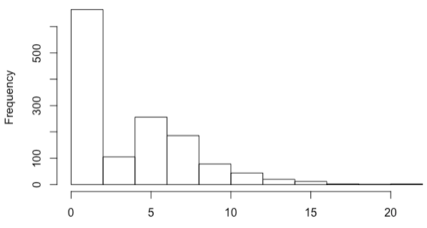
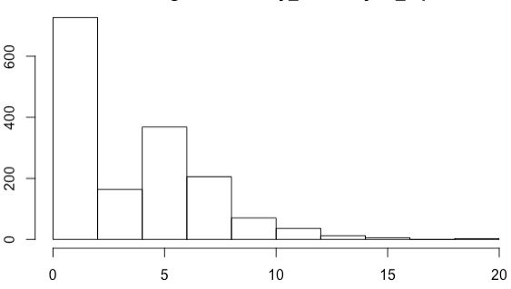
Data preparation – Daily homework time
To correct for skewness → square-root transformation
Older siblings daily homework time (square-root transformed)
Younger siblings daily homework time (square-root transformed)
Notes:
Combine this with the previous slide

Slide 19
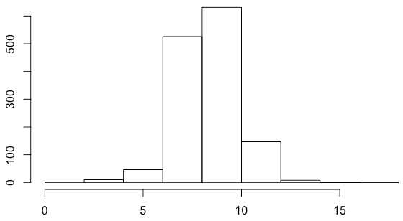
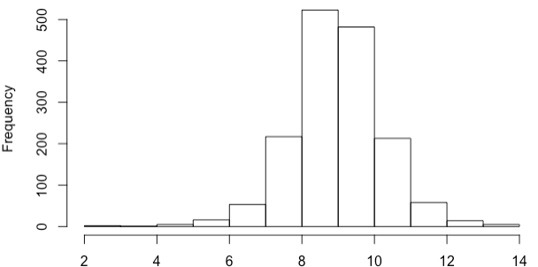
Data preparation – Nightly sleep duration (in hr)
Older siblings (N = 196)
M = 8.53, SD = 1.5
Range 1 - 18
Skew = -0.04; Kurtosis = 2.27
Younger siblings (N = 227)
M = 9.19, SD = 1.26
Range 2 - 14
Skew = -0.15; Kurtosis = 1.89
Notes:
Very well distributed – so not transformed

Slide 20
Results: Within-Person v. Between-Person effects
Older siblings
Fixed effects
Intercept 5.85***(1.35)
BP sleep duration -0.27 (0.16), p = .083
WP sleep duration -0.48 (0.09)***
Random effects
Intercept 1.62 [1.37, 1.92] (sig.)
WP sleep duration 0.62 [0.40, 0.95] (sig.)
cor (Intercept, WP) -0.99 [-0.88, 0.23]
Residual 3.47 [3.32, 3.63]
Younger siblings
Fixed effects
Intercept 2.05 (1.45)
BP sleep duration 0.13 (0.16)
WP sleep duration -0.41 (0.08)***
Random effects
Intercept 1.24 [1.03, 1.50] (sig.)
WP sleep duration 0.34 [0.18, 0.63] (sig.)
cor (Intercept, WP) -0.99 [-0.90, 0.45]
Residual 3.23 [3.11, 3.35]
The association between sleep duration and homework time is more intradividual than interindividual: Controlling for person’s mean sleep duration, on occasions where the youth reported higher sleep duration than usual, they also reported less homework time than usual
Notes:
Getting more sleep time-> more efficient in homework completion or spend less time on homework?
Visual

